Slide 1
Epic Battles of History
Antonio Arenas Vidal
Gustavo Valery
Robert Jones Ismael Fernandez

Slide 2
Overview
Epic Battles of History is a “gacha” game, a genre of mobile games based on summoning characters to participate in battles.
Summon rates for playable characters are low, so players must save up tokens to unlock them!
Once unlocked, the player can use their special character to battle enemies and get more tokens.

Slide 3
Implementation
Epic Battles of History uses one main activity that launches multiple fragments, changed when the user selects menu options:
Register // user registers account
Login // access your account
Home // world map contains battle markers
Battle // displays enemy’s and your health bar, attack!
Characters // list of characters you’ve unlocked
Summon // use your tokens to unlock characters

Slide 4
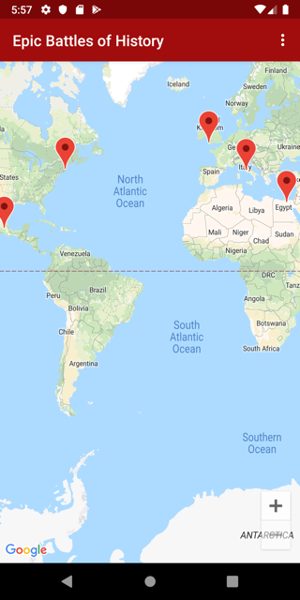
World Map
Red markers indicate battles that are unavailable; summon the appropriate gold character to play!
Menu options at top right

Slide 5
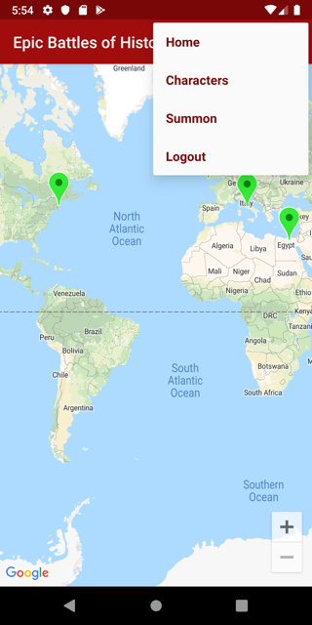
Menu Options
Click an option to move to another fragment
This map shows green markers; these are playable battles

Slide 6
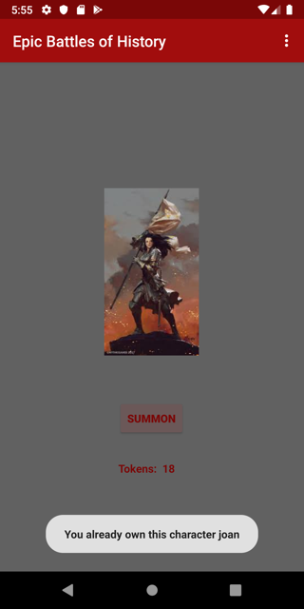
Summon
Use your tokens to summon a random character
Characters are bronze, silver, or gold; only gold ones unlock battles

Slide 7
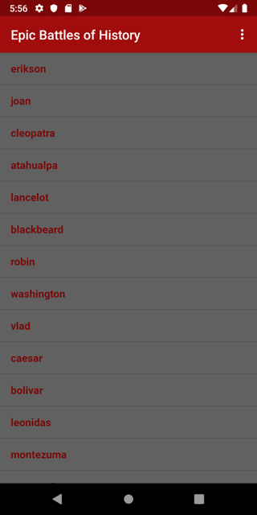
Characters
View the characters you’ve unlocked
Clicking a bronze or silver takes you back to the map, clicking a gold takes you straight to battle

Slide 8
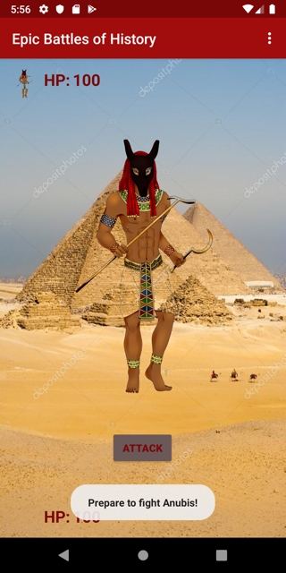
Battle
Click the attack button to reduce your enemy’s health, he will attack you back
Whoever reaches zero first loses!
Winning gets you 5 tokens

Slide 9
Now for a live demonstration!

